Slide 1
The Safer Islington Partnership
Johnathon Gallagher
Community Safety Manager

Slide 2
Safer Islington Partnership
The Safer Islington Partnership (SIP) co-ordinates work on crime reduction and community safety in Islington.
The council is a lead authority in this partnership along with:
Police
London Fire Brigade
Health sector
Probation services
Representatives from voluntary, community, faith and business sectors.

Slide 3
Safer Islington Partnership
SIP focuses on five key themes:
Crimes Involving Young People
Hate Crime & Anti-Social Behaviour
Drugs & Adult Offending
Violence Against Women & Girls, Domestic Abuse
Exploitation & Extremism
Each year the partnership carries out a strategic assessment of crime in the borough, which is used to determine local priorities and in developing plans and strategies to respond. The work of delivering on these priorities is devolved to partnership subgroups which report back to SIP strategic board

Slide 4
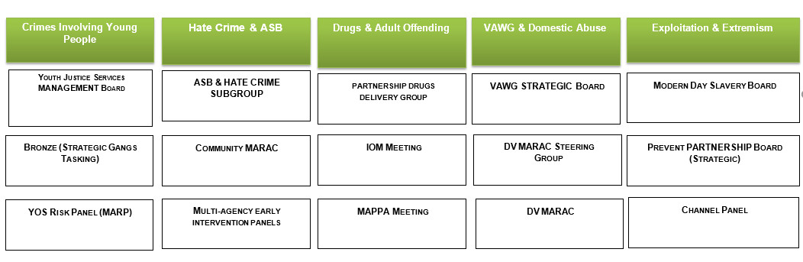
Safer Islington Partnership
SIP Strategic Board

Slide 5
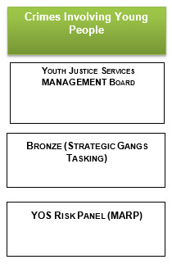
Safer Islington Partnership

Slide 6
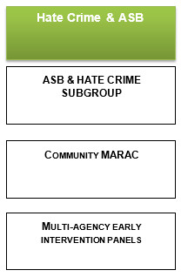
Safer Islington Partnership

Slide 7
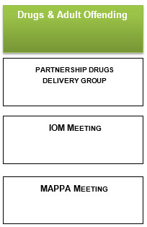
Safer Islington Partnership

Slide 8
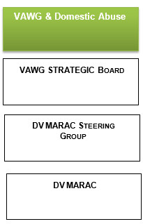
Safer Islington Partnership

Slide 9
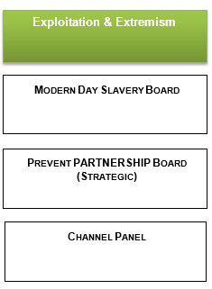
Safer Islington Partnership

Slide 10
Safer Islington Partnership
Crime Overview Summary
Safer Islington Partnership have led on five key areas: Crimes Involving Young People, Hate Crime & ASB, Drugs & Adult Offending, VAWG & Domestic Abuse and Exploitation & Extremism
Overall crime reduction of 5% (over 1,600 fewer victims) while crime across London rose 4%
Small increase in violent crime (0.4%)
Significant reduction of over 60% in theft snatch offences, through our coordinated partnership response
Continued reductions in Serious youth violence (-3.5%), youth violence (-6%), gun crime (-17%), knife crime offences (-14%), and knife crime victims under 25 (-10%)
27% reduction in robbery offences in the past year (following a peak in offences in 2017/18). The police now have robbery cars available, allowing for quicker identification of perpetrators
Domestic violence offences continue to rise (7%) in line with London increase but positive outcomes for victims remain a challenging area
There has been a small increase (6%) in racial crime but reductions in all other forms of hate crime

Slide 11
Safer Islington Partnership
For more information contact
Johnathon Gallagher
020 7527 8833
Johnathon.Gallagher@Islington.gov.uk

