Slide 1
State of Play: People and Crime Patterns in Islington
Karolina Bober, Project Manager (Youth and Community Team), Islington Council
10 July 2019

Slide 2
Youth Crime Priorities
Gangs
County Lines / Drugs
Knife Crime
Safeguarding young victims of crime
Addressing reoffending by young people
The youth offer

Slide 3
Crime Summary – June 2019
27% reduction in robbery offences in the past year (following a peak in offences in 2017/18). Ongoing proactive work targeting offenders by Operation Venice, with a focus on linked series. There have been a number of successful arrests. The police now have robbery cars available, allowing for quicker identification of perpetrators
Violence against the person, including youth violence and knife crime remains a priority for the Safer Islington Partnership. The council’s new Knife Harm Reduction plan is underway. The IGT continue to successfully work with young people involved in gangs. There has been a reduction in serious youth violence.
There has been ongoing multiagency work around hot spots across the borough that are recording higher rates of crime and ASB compared to the borough average. This includes the Finsbury Park area, Archway/New Orleans and Cally among others.

Slide 4
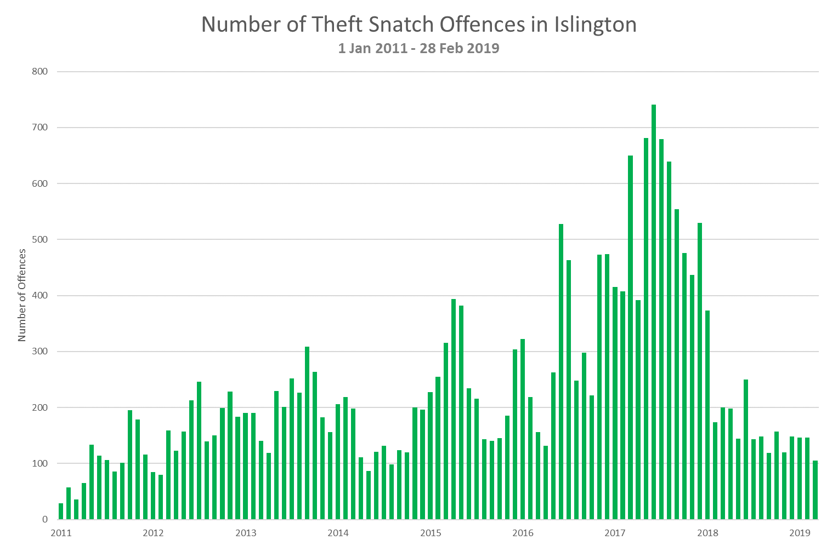
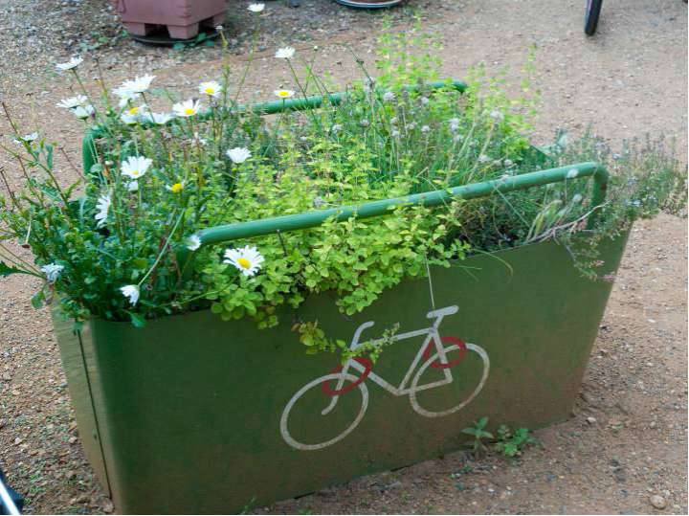
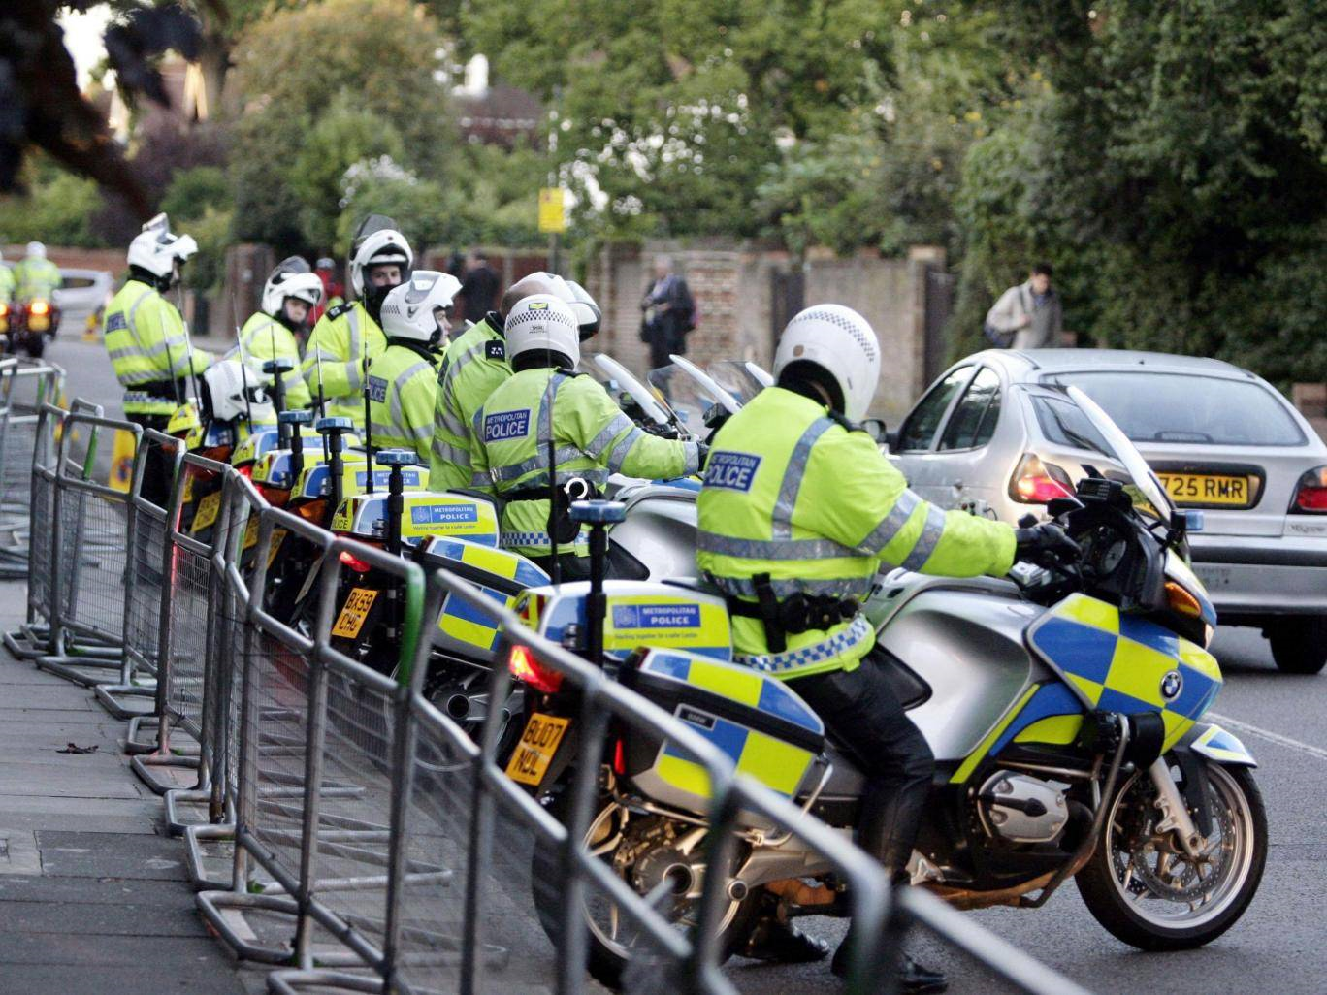
  Theft Snatch and Partnership Working
  There has been a 70% reduction in theft snatch offences in 2018/19 compared to 2017/18

Slide 5
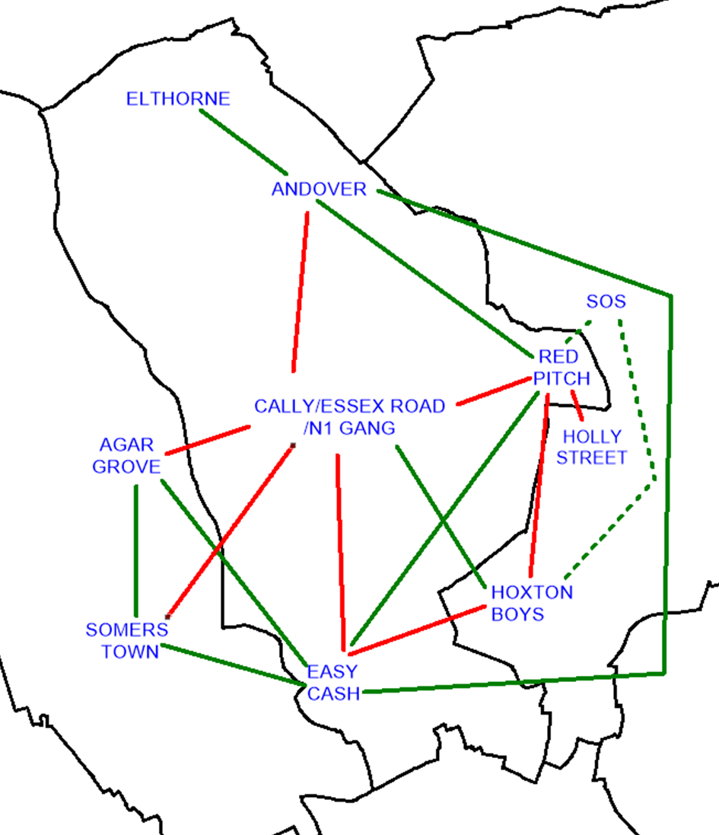
Gang picture
There are currently 5 known gangs operating in Islington. The following map shows main alliances and rivalries. This includes alliances and rivalries with gangs in neighbouring boroughs.
There are currently tensions between Cally Gang and Easy Cash and also Cally Gang and Andover.
KEY
Alliance
Rivalry
Unconfirmed Alliance

Slide 6





County Lines: What does it look like?
Children or adults can either be recruited by a gang or dealer, or they are already established gang members or drug dealers.
Children are more likely to be targeted due to vulnerability and/or likelihood of evading detection.
Trains and cars are frequently used.
Use of hire cars to evade detection.
Young people may be driven by another adult to the location.
Young people may transport drugs by carrying them internally (‘plugging’).
Locations targeted have a market need for drugs; i.e. university towns, coastal and other tourist towns.
County lines are also set up by the placement of looked after children or the housing of adult gangs members.
Preparation and organisation of the sale of drugs. The address tenant is likely to be a drug user and dependant on dealer/gang.
Young people often sleep at the address (reporting poor conditions)

Slide 7
Drugs Issues
Camden and Islington Drugs Strategy 2018-21 has a focus on:
    Increasing policing and enforcement
    Providing support for those who need it
    Improving the local area
    Engaging local young people and providing a range of positive activities
One of the biggest hot spots in Islington is Finsbury Park, where there is currently a tri-borough and policing joint action plan being implemented to tackle drugs and related issues in the area.

Slide 8
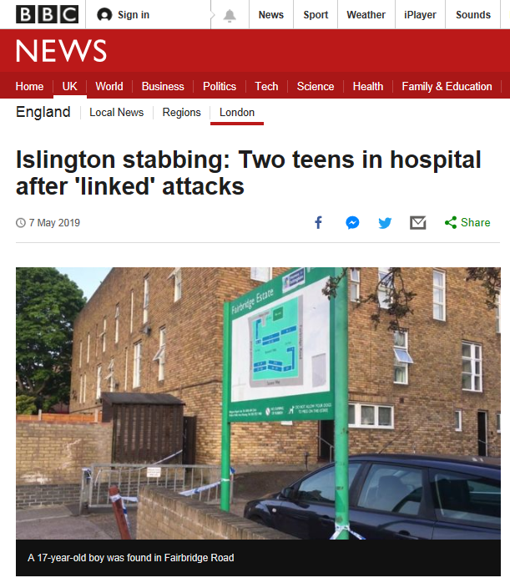
Knife Crime
Knife crime is a priority across London and nationally.
Levels of recorded knife crime in Islington are 80% higher in 2018/19 compared to 5 years ago, although in the past year we have seen an 8% reduction (MPS data).
Islington is implementing a knife harm reduction plan. There is a task and finish group.
Everyone can have a role to play in tackling knife crime.

Slide 9
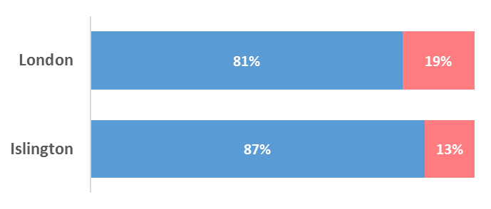

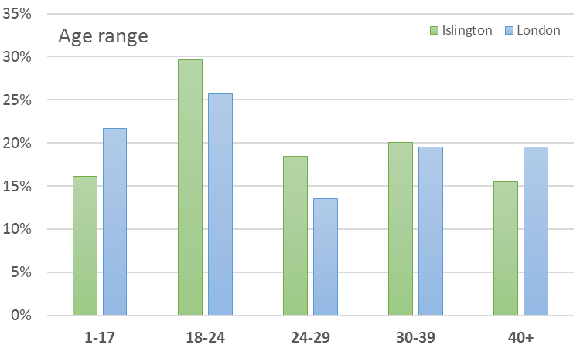
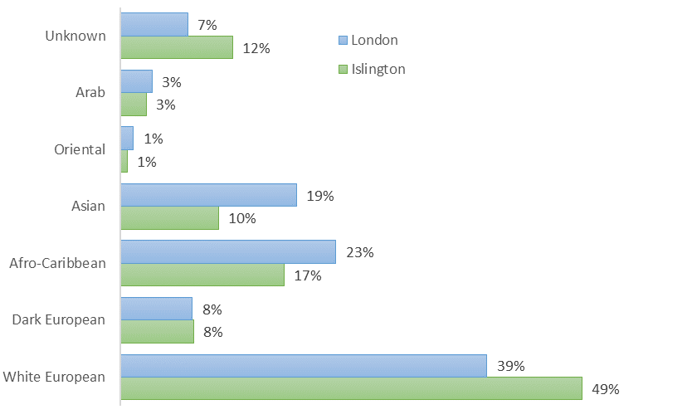
Victims of Knife Crime compared to London (12 months)
Significant difference for victims aged under 18. The 18-24 age has a bigger proportion of victims than London.
Male victims are overrepresented compared to the London. Believed due to the robberies in Archway
Significantly higher White European victims, the target for knife point robberies in the north

Slide 10
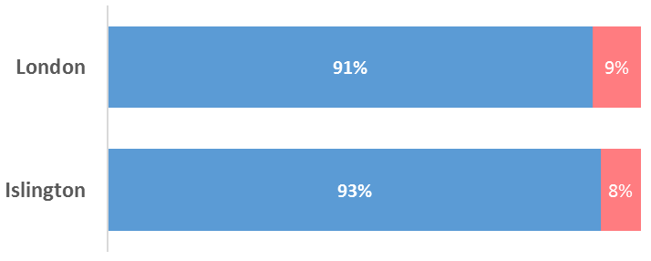
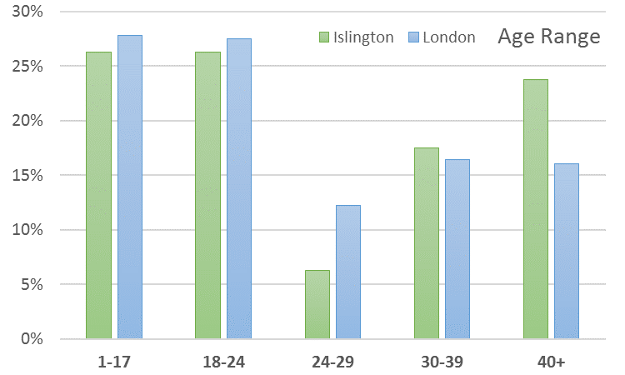
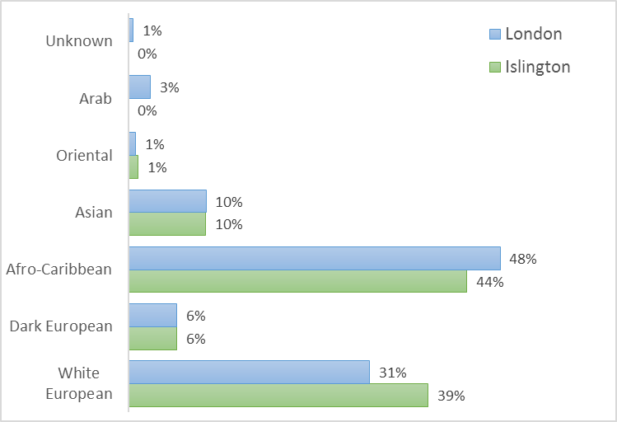
Accused of Knife Crime compared to London (12 months)
In Islington, the proportion of accused is significantly higher around the 40+ age range and significantly lowered for the 24-29 age range compared to London. Further needs to be explored as to why this is.
Gender for accused correlates with the London ratio.
White European accused is higher in proportion with regards to the London population. However, the figures are not in proportion with population breakdown.

Slide 11
Analysis of our most concerning young offenders– common themes
ADHD & Speech and Language difficulties
Several school changes (25 schools for 5 of the children)
School exclusion
Early childhood trauma particularly Domestic Abuse
Fathers offending/absent/becoming absent
Residing with Grandparents
Cannabis use prevalent
Lack of self-care noted
Gaps in statutory services from early childhood to adolescent
Common offending age- starting at 13/14

Slide 12
Partnership response
Working Together for a Safer Islington plan
YOS - Continued reductions in FTE and Youth custody
Rich community and voluntary sector offer in the borough
Enhanced prevention and sibling offer
Integrated Gang Team has achieved:
  Decrease in knife crime victims under 25 (gang flagged)
  - Increase in gang exits with reduced harm score
Safe Havens project initiated with over 40 premises signed up.
Youth violence prevention toolkit rolled out to all Islington schools
Extensive ‘Open for All’ play and youth offer with increased provision at weekends
Mentoring primary & secondary – Chance UK and Safer London
Key working St Giles Trust
Community Weapons sweeps involving residents in our hotspot locations

Slide 13
Targeted Youth Support service offer
TYS workers
Missing and exploited team
St Giles Key workers
Mentoring service (Safer London and Chance UK)
Abianda (The Star Project)
Youth Counselling Service
Islington Young People’s Drug & Alcohol Service (IYPDAS)
Sexual health service

Slide 14
Current council-funded ‘open for all’ youth offer
Lift and Platform Youth Hubs
Rose Bowl, Soapbox and the Zone
‘Youth at the Centre’ – community based youth offers (Mary’s, Highbury Roundhouse and Copenhagen Youth Project)
‘Ambitious Communities’ – social action projects, entrepreneurship, co-producing solutions with young people
‘Small Change, Big Impact’ – community based projects such as Islington Boxing Club, iIndigo, Ben Kinsella Trust
Summer programmes – ‘Summerversity’ and ‘Launchpad’ aimed at 13+ and 16+ ages respectively

