Slide 1

25 June 2020
@LondonFunders

Slide 2
About London Funders
London Funders is the membership network for funders and investors in London’s civil society – 160 members, across all sectors
We’re here to enable funders from all sectors to be effective. We’re focused on collaboration – convening funders to connect, contribute and cooperate together, to help people across London’s communities to live better lives.

Slide 3

#WeStandWithTheSector
Over 370 signatories
  www.covid19funders.org.uk
Website updated with links to statements and news from funders on their work
Check if your existing funders are already signed up
  adapting activities, discussing dates and financial flexibility

Slide 4
London Community Response
63 funders, £23.5m committed to date
A single, simple application form
A funder only portal means eligible applications are viewed by multiple funders leading to fast decisions based on needs
www.londoncommunityresponsefund.org.uk

Slide 5
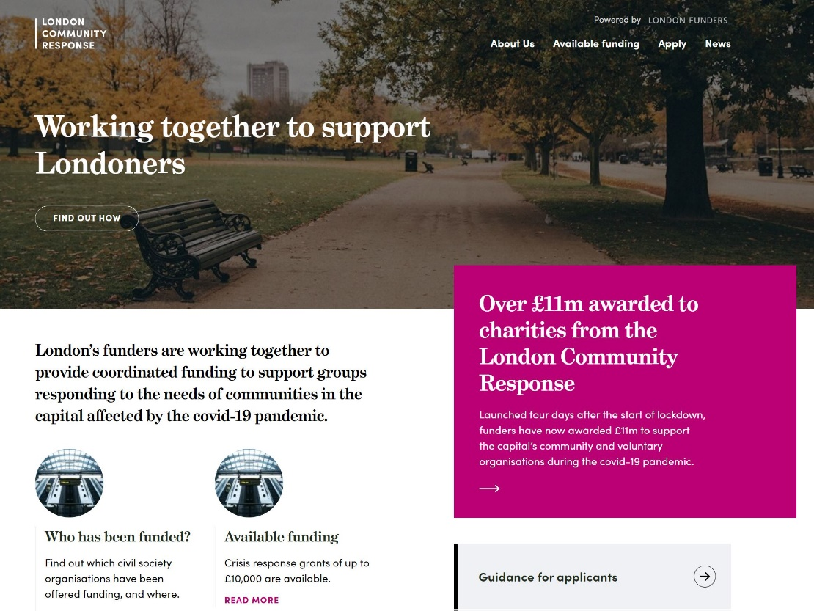


Funding already awarded
Over 1,600 grants, £21m+ given out so far

Slide 6
Moving into wave three
Wave one – react
  Focused on food and essentials
Wave two – respond
  Crisis response, and delivering differently
Wave three – resource
  Aiming to launch w/c 29 June 2020

Slide 7
Wave three: amounts
Small – grants of up to £10,000, using a simple application form, with decisions typically made within two to three weeks
Large – grants of up to £50,000, involving a longer application form, with decisions typically made within six to eight weeks
Potential for larger applications where there is a strong rationale for this
Funding is for up to six months

Slide 8
Wave three: eligibility
For either small or large grants:
  Registered, exempt or excepted charity
  Charitable incorporated organisation (CIO)
  CIC limited by guarantee
  Charitable company (limited by guarantee)
  Registered charitable industrial and provident society, or charitable cooperative (Bencom)
In addition, for small grants:
  Faith group, where the activity is not promoting religion
  Registered Community Amateur Sports Club
  Constituted but unincorporated club or association
  Constituted Tenants and Residents Associations, and Tenant Management Organisations
  Constituted community group

Slide 9
Wave three: priorities
Equity and inclusion – organisations led by and for marginalised communities and those most affected by the covid-19 crisis (particularly Black, Asian and Minority Ethnic (BAME); Deaf and Disabled; Lesbian, Gay, Bisexual and Transgender (LGBT+); and/or women’s-led groups)
Strong connections – groups who reach and connect with people at high risk of negative impacts from Covid-19 (in terms of health outcomes, as well as social and economic issues)
Smaller organisations – typically those with a turnover of under £1m a year.

Slide 10
Wave three: themes
Advice
Arts and culture
Children and young people
Domestic abuse and VAWG
Equity and inclusion
Food
Homelessness
Infrastructure (civil society support)
Mental health and wellbeing
People at risk
Refugees and migrants

Slide 11
Wave three: strands
Crisis
  “we will continue to offer funding to provide food, essentials and support through crisis.”
Enable
  “we will fund work that helps to prevent difficulties escalating, and that enables people to emerge from crisis.”
Adapt
  “we will fund work that helps groups to restart, adapt or collaborate for the future.”

Slide 12
Crisis could be…
Access to food, including hot food, for those most in need and who are not reached by public services (including people at risk, children and young people, parents and families, and people with No Recourse to Public Funds (NRPF));
Access to essentials for people facing crisis so that they can access services and support safely (including people experiencing domestic abuse/VAWG, homelessness or NRPF, and children, young people and families);
Adaptations to essential services so that they can be delivered through digital or other safe and accessible channels, so that positive activities and outcomes can be maintained;
Additional costs services are experiencing (e.g. deep cleaning of premises or accommodation, or provision of PPE) to continue to deliver during crisis; and/or
Support for people experiencing uncertainty, loss and grief.

Slide 13
Enable could be…
Advice to people on benefits, employment, housing, and/or immigration problems (reaching people who are experiencing difficulties for the first time, supporting those with complex issues, and/or boosting capacity to deal with increases in demand for advice and casework);
Support for people on mental health and wellbeing, including tackling isolation and loneliness;
Youth work that supports positive summer and autumn activities, violence and vulnerability prevention (including with those involved with the criminal justice system), educational attainment, and/or transitions, including detached youth work;
Increased capacity to support people experiencing domestic abuse/VAWG to be safe; and/or
Support for people to make sustainable transitions from situations of homelessness.

Slide 14
Adapt could be…
Developing and enhancing services, for example via remote and accessible channels, to build on what worked well in responding to crisis so that more people can be supported in the future;
Support for organisational change to ensure sustainability of impact or extend reach, for example through enabling mission-focused mergers, partnerships and collaboration;
Work that enables organisations and services to re-open and increase capacity effectively (including making venues/centres/offices safe, training and development, and bringing teams together after furlough);
Developing and implementing plans and models to ensure longer-term sustainability; and/or
Research, policy and advocacy work to ensure the voices and experiences of people affected by the crisis inform changes in policy and practice for the future.

Slide 15
What is the funding for?
People – staffing and volunteer costs associated with delivering the work you are applying for;
Support – supervision and support for your team, including wellbeing and specialist support;
Equipment – any equipment you need to deliver this work that is not already in your budget;
Resources – any new software or training needed for your team to do their work;
Services – meeting the needs of the people you work for, including food and essentials, translation or interpreting services, or deep cleaning of accommodation (a small number of funders can also cover the costs of vouchers given to people to buy these items directly);
Overheads – direct additional costs (e.g. for home working), together with a proportionate contribution to your organisational costs (including your governance costs);
Partnership – staff time, professional fees, or support needed to enable collaboration; and
Development – contributions to capacity building, infrastructure and organisational development.

Slide 16
Timelines
Expecting to launch next week
Applications will be considered as they come in
Expect to close for new applications by the end of July (details will be on website)
www.londoncommunityresponsefund.org.uk

