Slide 1
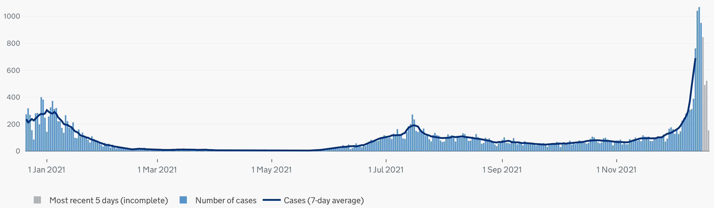
Diagnosed Covid-19 infections - Islington

Slide 2
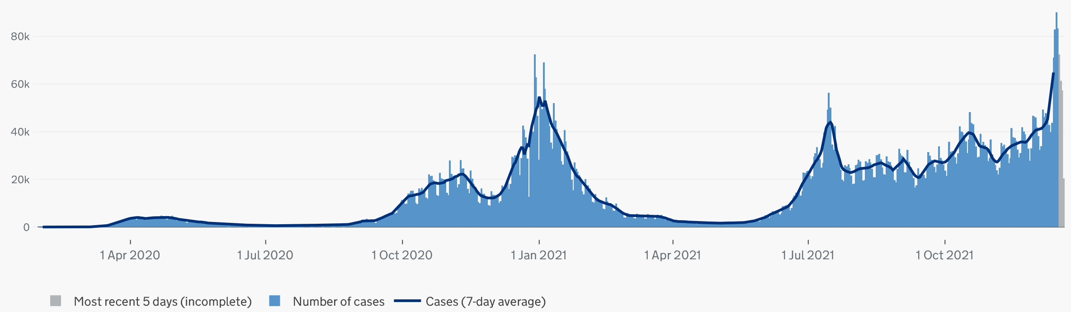
Diagnosed Covid-19 infections - national

Slide 3
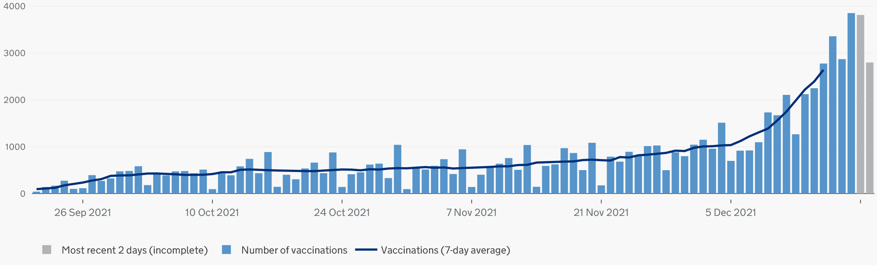
Covid-19 booster vaccinations - Islington

Slide 4
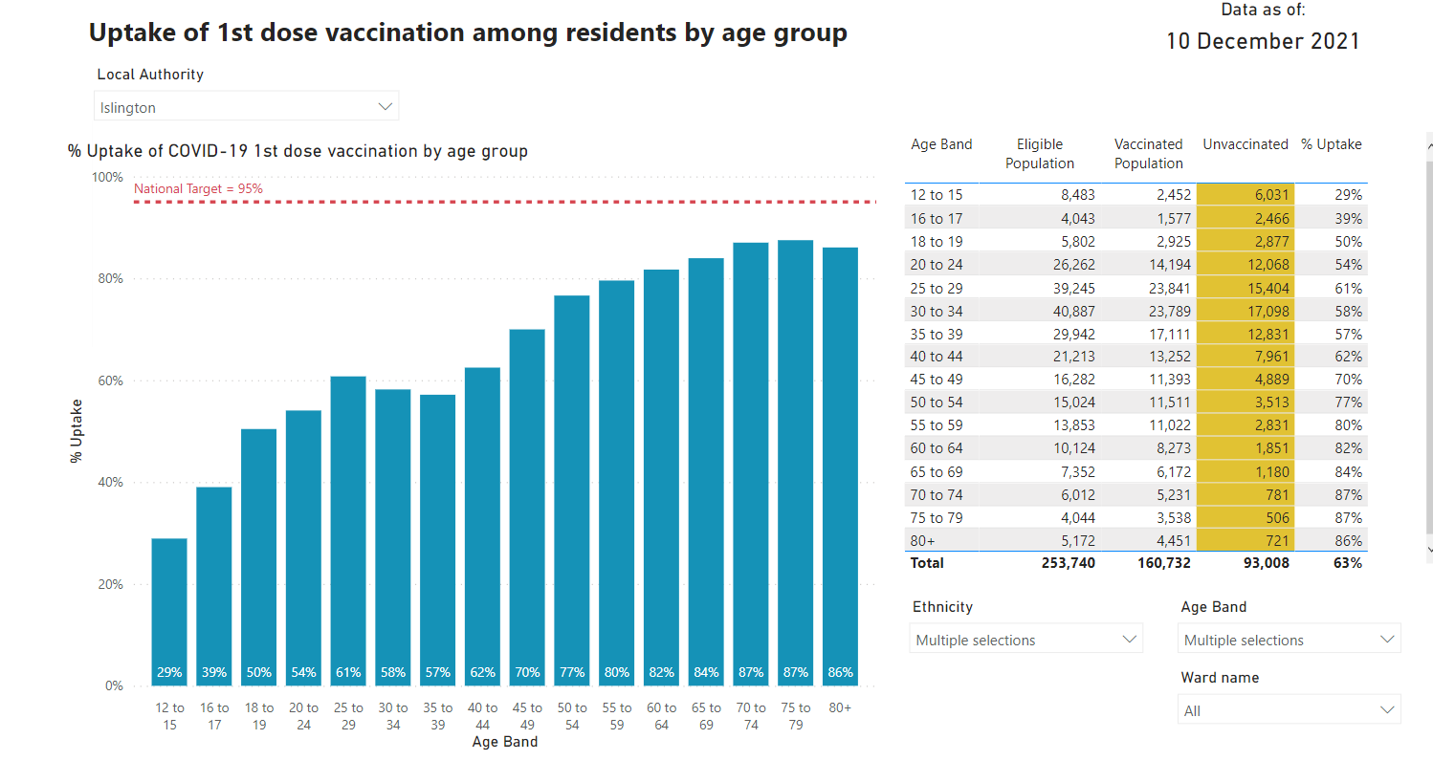
Source: PHE COVID19 Situational Awareness portal 10th of December

Slide 5
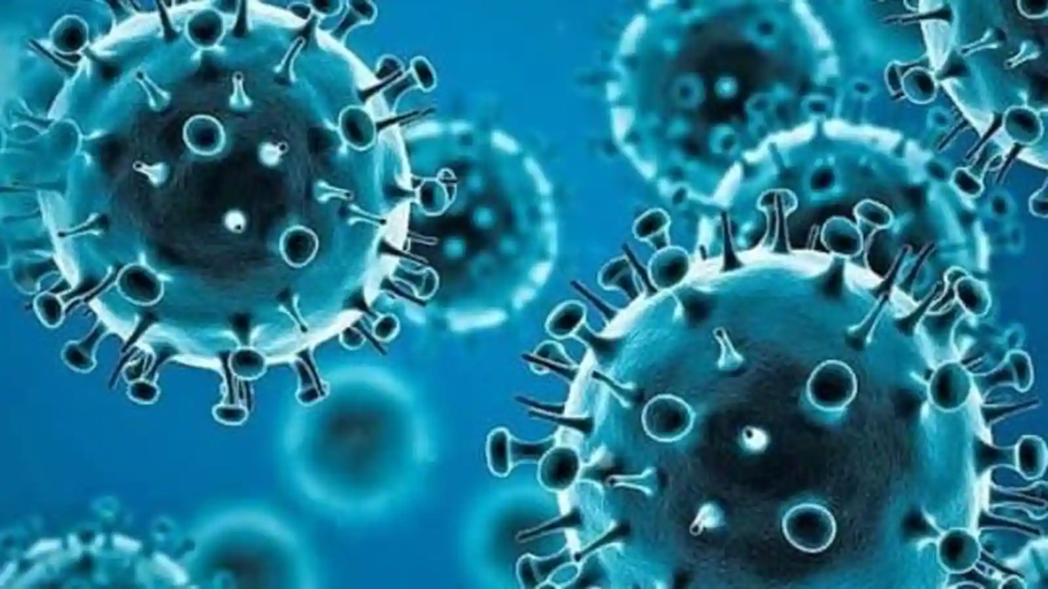
What do we currently know (or don’t know) about Omicron
Mutations
Infectivity
Incubation period
Spread
Severity
Serious illness, hospitalisation and mortality
Vaccination and post-infection immunity
Other protective/safety measures

Slide 6
Serious illness, hospitalisation and mortality
What could the next few weeks and early 2022 hold? LSHTM
What are the scenarios?
In the most optimistic scenario, which assumes Omicron has low immune escape and booster jabs are highly effective, the model projects between 1 December and 30 April in England there will be:
20.9 million infections
175,000 hospital admissions
24,700 deaths
In the most pessimistic scenario, which assumes Omicron has high immune escape and booster jabs are less effective, the model projects between 1 December and 30 April in England there will be:
34.2 million infections
492,000 hospital admissions
74,900 deaths

Slide 7
How protective is pre-existing immunity?
Protection against symptomatic infection and re-infection is significantly reduced against Omicron compared with Delta
  Re-infection risk (i.e. in people who have previously had Covid) 2.4-3 times higher
  Protection against symptomatic infection after two doses of Pfizer down to 40%; AZ down to 10%
  In part may be due to waning antibody immunity over time, but mainly the change in the virus mutation
Booster restores a significant level of protection against symptomatic infection
  Pfizer or Moderna as booster after double AZ most potent
  15 to 20-fold increase in antibodies
  Protection against symptomatic infection rises to 70-75%
Level of protection against serious illness or hospitalisation with Omicron is very early to establish. It is expected that there will still be significant protection, but it may be lower - early analysis suggests a reduction of 80-86% following booster, compared with c. 95% with Delta.

Slide 8
In the workplace:
Follow risk assessment
Signage and layout
2M distancing when in the office, including when at breakout areas
1 person per lift
Regular Lateral Flow Tests – at home
Do not attend the office if you have symptoms
Wear type 2R masks when sharing work vehicles

Slide 9
Other protective and safety measures
Vaccinations are our single most effective ways of protecting ourselves and others from Covid-19
Other public health measures remain very important and protective, including:
  Face coverings worn properly in indoor public places (mandated locations or not) – protects others, and may protect you to a lesser degree
  Meeting outdoors
  Ventilation indoors
  Stay local, shop local
  Reducing social mixing between households
  Regular lateral flow testing, and before and after social gatherings
  PCR testing and isolating if symptomatic until result
Plan B involves requirement to
wear face coverings in most public indoor places
Proof of vaccination status, a recent negative LFD tests or proof of recent infection (‘vaccine passports’) at larger indoor or outdoor venues or events
Guidance to work at home where possible
VOLUNTEERING!

