Slide 1
Islington Adult Social Care
Islington's Corporate Priorities - Strategic Plan 2021
Stand up for equalities
Our purpose is to achieve change for our residents who are at the heart of everything we do
Listening to our communities, understanding their experiences and aligning our priorities with theirs
Work in partnership with our communities
Deliver positive impact for our residents
Embrace change and innovation
Committed to early intervention and prevention

Slide 2
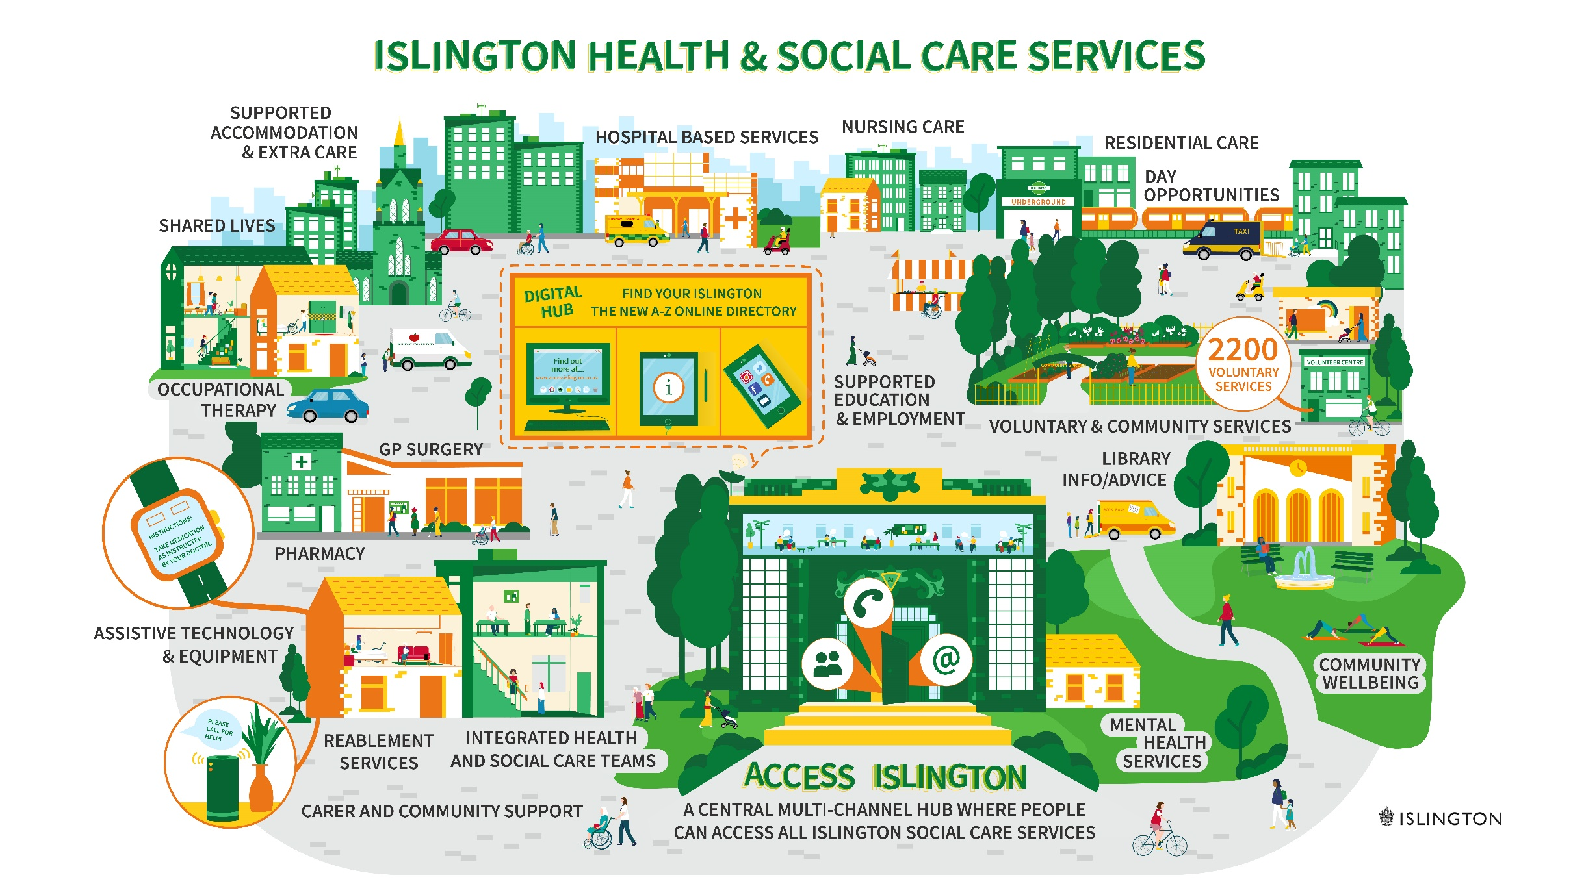
Islington Adult Social Care vision - For Islington to be a place made up of strong, inclusive and connected communities, where regardless of background, people have fair and equal access to adult social care support that enables residents to live healthy, fulfilling and independent lives.

Slide 3
Islington Adult Social Care Co-Produced Principles
Coproduced with our residents, carers and staff, these principles will sit at the heart of Islington’s adult social care offer, shape the transformation programme and support quality management.
Islington ASC will:
1. Listen to you and involve you in what we do and how we do it.
2. Work with you to strengthen your sense of safety, wellbeing and belonging.
3. Be clear about the choices you have and the support available to you.
6. Help you to connect with the VCS and community groups and to continue supporting and learning from each other.
5. Improve the quality and consistency of services and celebrate success.
4. Offer the right support at the right time, based on your strengths and what’s most important to you.

Slide 4
Islington Adult Social Care Offer – achieving better outcomes for residents
The right support
The right place
Getting the right support to keep residents safe. Reduce or delay the need for longer term services using targeted support and assistive technology.
Assisting residents to remain at home, with access to the full range of community services that Islington has to offer.
The right time
The right network
Resolving issues at the first point of contact wherever possible, to maximise residents' resilience and independence.
Working with the resident, their support network and our partner organisations to achieve better outcomes and make the most effective use of our resources.

Slide 5

ASC Operating Model 2022
Prevention and Early Intervention – inc Bright Lives
Work proactively to build on residents' skills, resilience and capacity to make positive and sustainable changes in the community.
Online Offer
Helpline Offer
Community Offer
Connecting Offer
Coaching Offer
Proactively taking all opportunities to build on people's strengths, maximise their independence and connecting them with their community, ensuring equality and fairness throughout.
Problem Solving at the first point of contact – up to 6wks
Highly skilled staff utilising a strengths-based approach to ensure a proportionate response to the presenting need.
Advice and guidance
Signposting
Initial assessment/identifying support to maximise independence
Onwards referrals
Safeguarding/Response to Merlin reports
Legal action/liaison
Prevention and Early Intervention including Bright Lives – Early Help
Voluntary Sector and Partners
Problem solving at the first point of contact
Outcome focused short term intervention – up to 6 wks
A joint focus on maintaining or improving independence by initiating short term creative interventions
Establishing or initiating referrals to preventative interventions
Unplanned reviews/amend offer appropriately
Outcome Focused Short
Term Intervention
Responding to
Complex Needs
Responding to complex needs – up to 6 month
Holistically managing complex situations, to achieve sustainable best outcomes for the resident
Assessment/Reviews/Development of support
Safeguarding/LPS/DoLS
Court work/Legal Liaisons
Specialist
Teams
Safeguarding and MCA

