Slide 1
Covid Update
8 Feb 2022

Slide 2
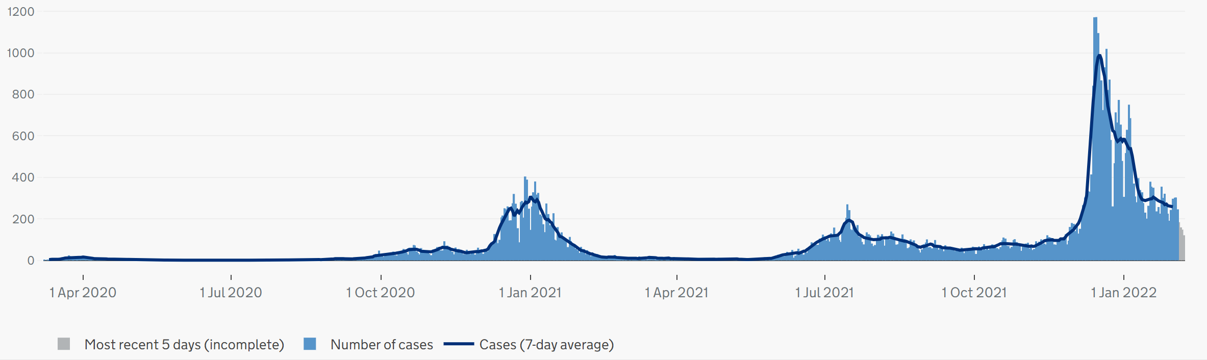
Confirmed PCR positive Covid infections – since March 2020

Slide 3
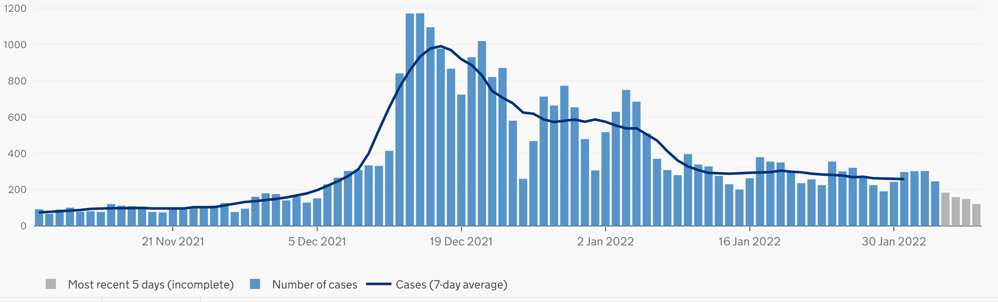
Confirmed PCR positive Covid infections – latest three months
The number of people in NC London hospitals with Covid has steadily decreased since the peak seen at the start of the New Year. There were just over 380 people in hospital beds with Covid at the start of this week – just over 40% with a primary diagnosis of Covid.
During this Omicron wave, the trend in deaths has not changed since the early autumn when Delta infections were dominant - averaging 1-2 deaths per week. In the most recent week, there were two deaths of people within 28 days of a confirmed Covid infection, bringing the cumulative number of people who have died with Covid in Islington to 413.

Slide 4
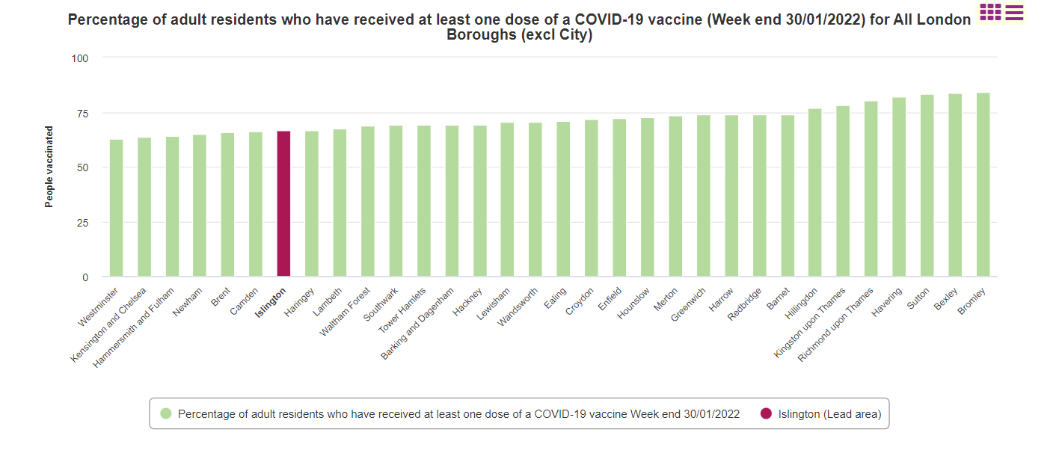
66.70% of Islington residents aged 18+ have received one dose of the COVID-19 Vaccine

Slide 5
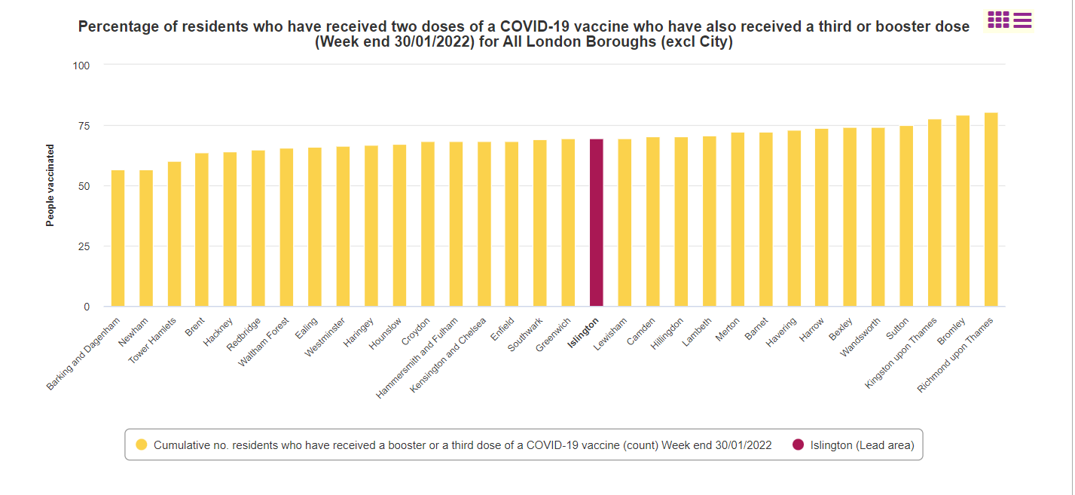
69.5% of residents who have received two doses of a COVID-19 vaccine who have also received a booster.

Slide 6
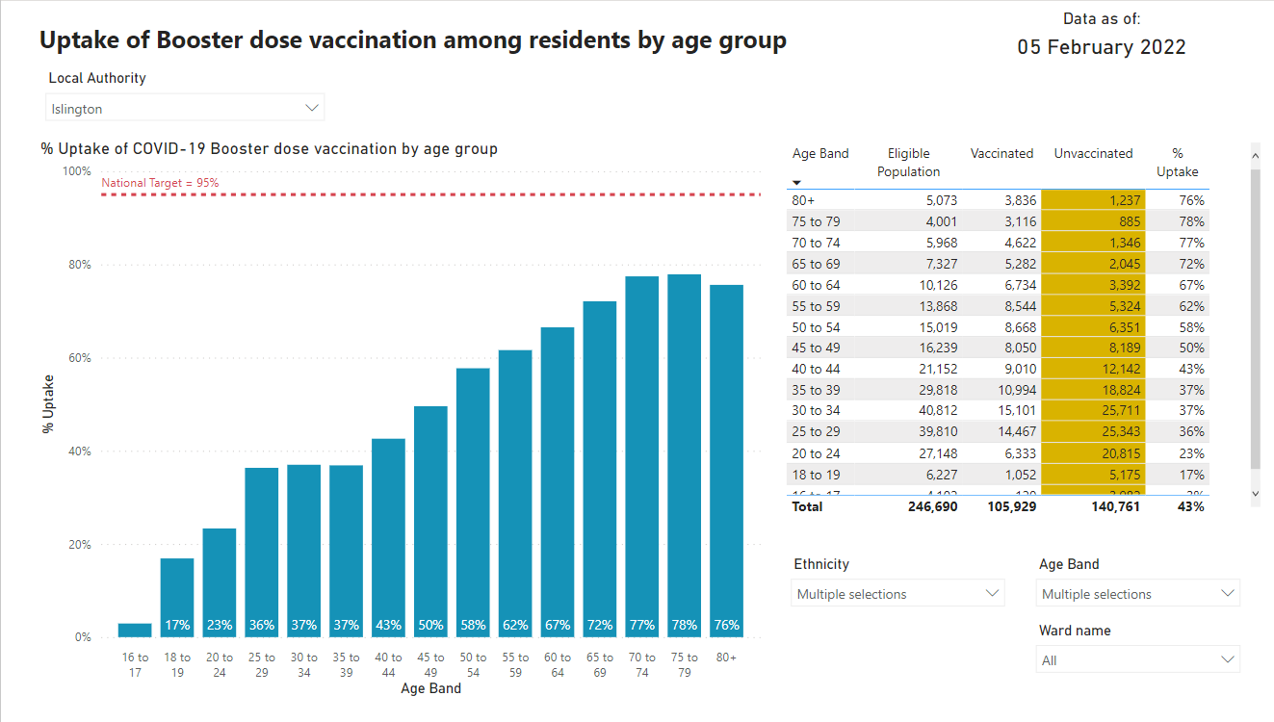
Source: PHE COVID19 Situational Awareness portal 5th of February

Slide 7
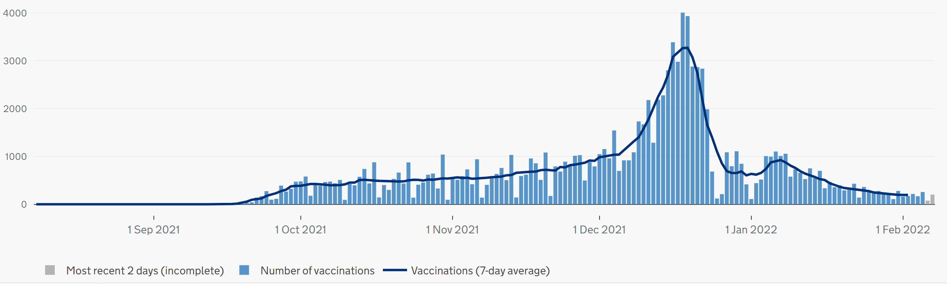
Vaccination trends
425k Covid vaccinations so far:
167k first doses (+5-600/week)
151k second doses (+6-700/week)
106k boosters (+1,400/week)

Slide 8
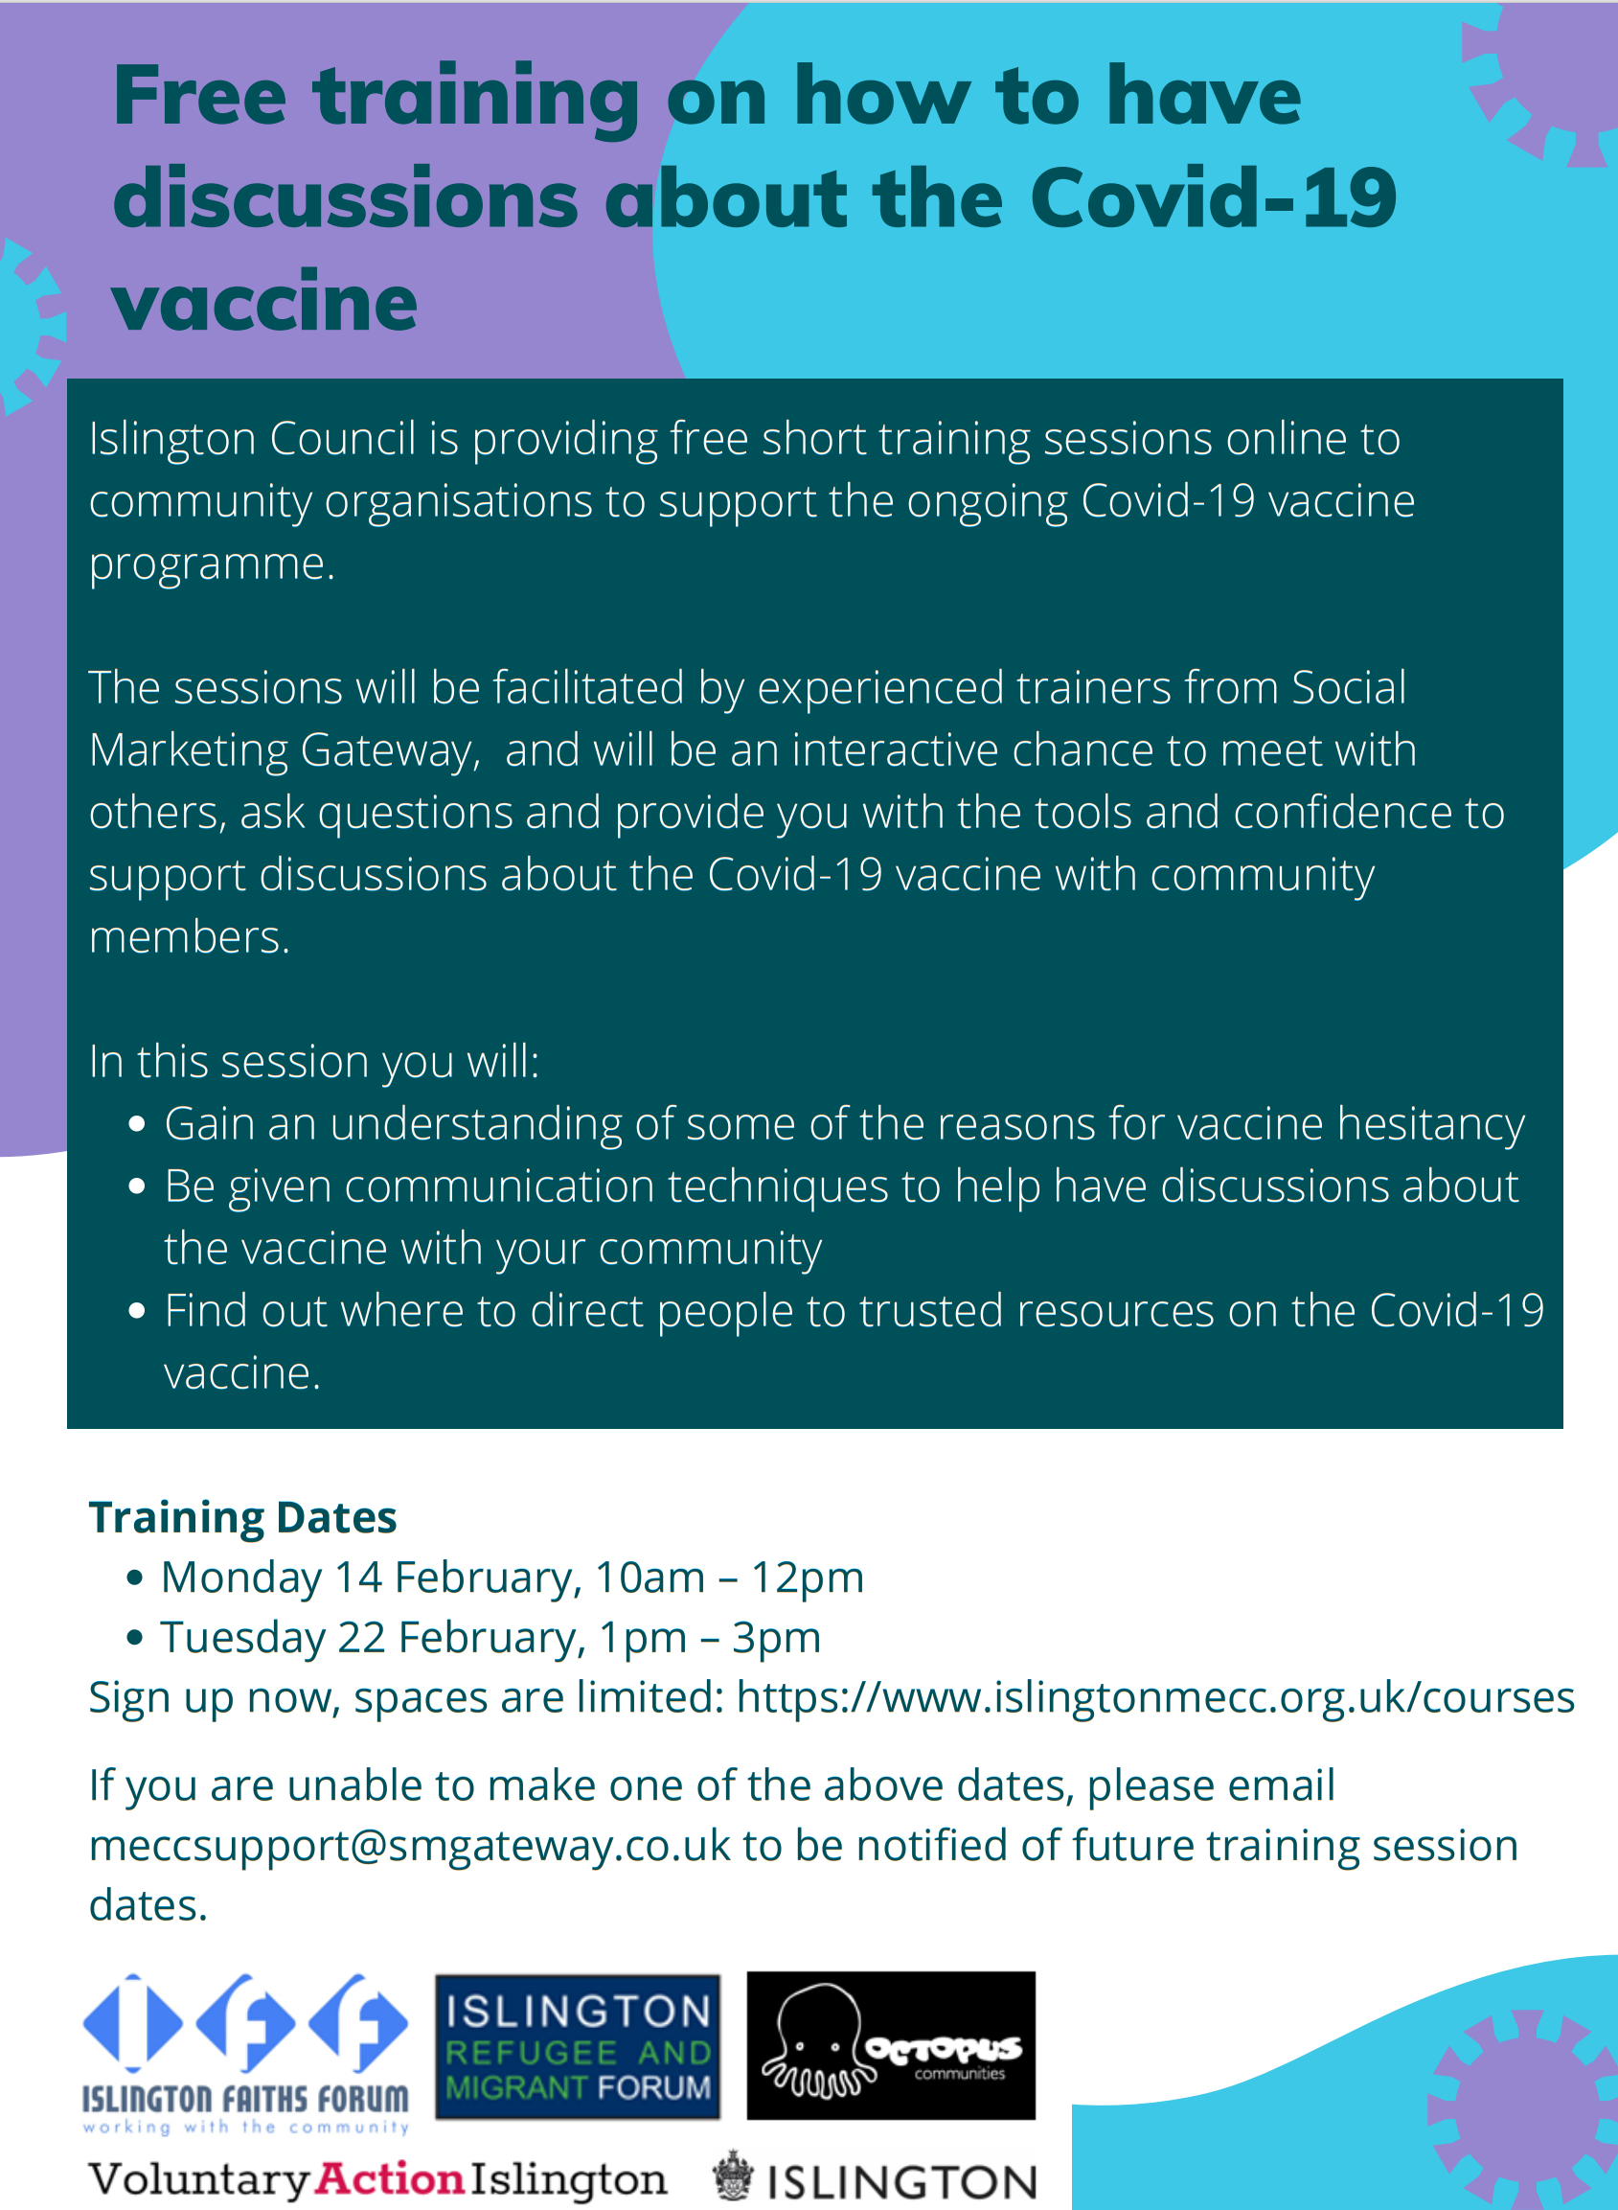
VCS networks and organisations are starting to develop new proposals for engagement work, including developing materials in community languages and videos / audio of community stories.
Public Health has just completed the analysis of the second survey of the direct and indirect impacts of Covid on local people and communities.
As we approach the second anniversary of the Covid regulations, there is national and regional work on-going about existing (or living) with Covid

Slide 9
Three key messages
The Covid vaccine offers you the best protection against serious illness, and against long Covid
The Covid vaccines are free – don’t be scammed into paying
It’s never too late to get your first vaccine – and you can walk in without booking if you prefer

