Slide 1


Slide 2
Leigh Andrews
Speech and Language Therapist
Chair, Royal College of Speech and Language Therapists’ Homelessness Clinical Excellence Network
Registered Intermediary for the Ministry of Justice

Slide 3

Speech and language therapists:
The missing link in homelessness.

Slide 4
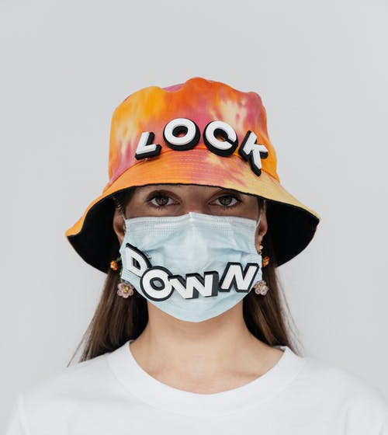
The ‘Everyone In’ Campaign 1

Slide 5
The ‘Everyone In’ Campaign 2
A Covid 19 screening questionnaire was created by GLA and partners in March 2020.
e.g. “In the last 7 days have you experienced a new cough, breathlessness or fever?”
Change Communication suggested different wording to make questions easier to understand.
e.g. (Use a calendar and point) “Today is Friday. Since last Friday have you:
Started coughing?
Felt out of breath?
Felt very hot?
(All questions supported by gesture / pictures).

Slide 6
The ‘Everyone In’ Campaign 3
The questions were not changed.
227 people were asked the GLA question.
How many people were found to be in the wrong Covid cohort?
Was this, in part, due to misunderstanding?
https://www.healthylondon.org/our-work/homeless-health/covid-19-resources/#heading1 Look under ‘case studies’.

Slide 7
The clinical education of SLTs includes…..
Alternative and augmentative communication
Anatomy and physiology
Audiology
Acoustic phonetics
Acquired language disorders
Autistic spectrum disorders
Cerebral palsy
Cleft palate
Deafness
Developmental language disorders
Learning disabilities
Mental health
Language processing
Research and evidence-based practice
Development through lifespan (in utero to end of life)
Ear, nose and throat
Linguistics
Neurology
Phonology
Professional studies
Speech and language development
Child speech disorders
Dementia
Dysfluency
Dysphagia
Motor speech disorders
Research methods
Voice

Slide 8
Some conditions with an impact on communication or swallow.
Acquired brain injury
ADHD
Autism
Cerebral Palsy
COPD
COVID-19
Deafness
Dementia
Head and neck cancers
Learning disability
Mental illness

Slide 9
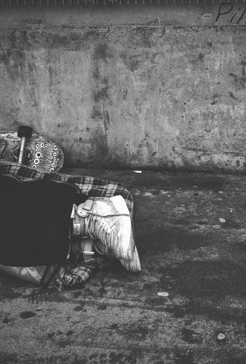
Research
Communication needs of rough sleepers are almost double that of adult general population.
Andrews and Botting (2020) “The speech, language and communication needs of rough sleepers in London.”
https://onlinelibrary.wiley.com/doi/full/10.1111/1460-6984.12572
People experiencing homelessness have difficulties understanding and expressing themselves compared to a matched control group.
Pluck et al (2020) “Language abilities and adult homelessness.”
https://onlinelibrary.wiley.com/doi/abs/10.1111/1460-6984.12521
Communication difficulties are a barrier to accessing healthcare say experts by experience.
Luchenski S., Maguire N., Aldridge R.W. et al (2018) “What works in inclusion health: overview of effective interventions for marginalised and excluded populations”, The Lancet. Vol 391, Issue 10117, pages 266-280.
One third of homeless deaths are from causes that are amenable to treatment.
Aldridge et al (2019) “Causes of death among homeless people: a population-based cross-sectional study of linked hospitalisation and mortality data in England.” https://doi.org/10.12688/wellcomeopenres.15151.1
GPs are not aware of the range of communication difficulties people may have.
Project: Chief Scientist’s Office (2004) “Consultation between GPs and people with communication disability.”

Slide 10



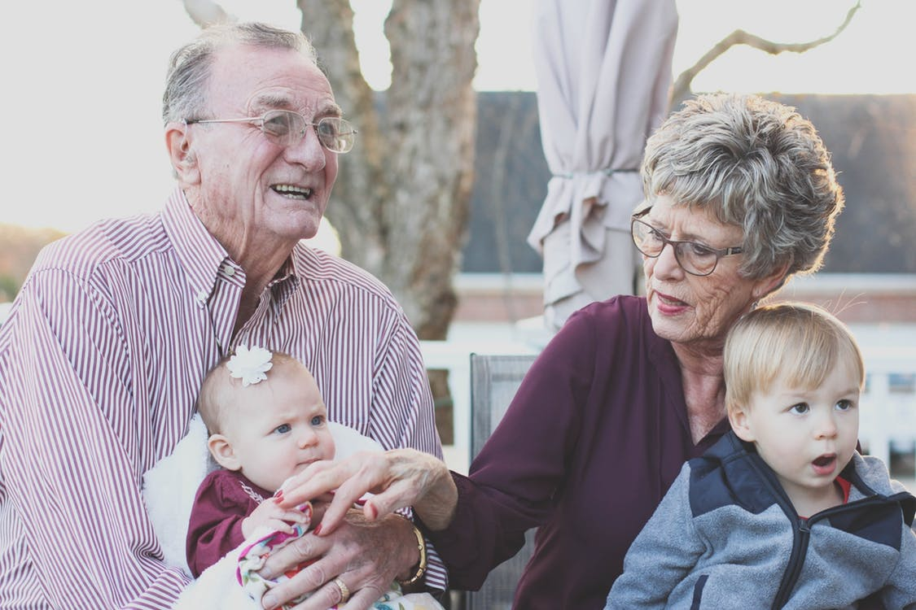
https://theconversation.com/ask-or-aks-how-linguistic-prejudice-perpetuates-inequality-175839

Slide 11

Communication First
“I am truly grateful for all the advice and strategies you gave me around communicating with D. It helped me connect with him and build a trusting relationship.”​
Pre-treatment​
Therapeutic alliance​
Unconditional positive regard
Psychologically and trauma informed

Slide 12
What people say:
“Thank goodness someone knows my problem.”
“I thought I was stupid.”
“You’re f….g quality.”
“Thank you so much for the communication training, its already a game changer!

Slide 13

The Law
Equalities Act 2010
Accessible Information Standard

Slide 14

We share information with people who help you.
Member information
We respect that as a member you may be required to share information with us that is often sensitive (special category data). Where we need to share this information with external agencies (such as housing authorities or services, or other charities where work in collaboration improve someone’s ability to leave homelessness for good) to help increase or progress the support available to you, we will only do this with a your explicit and informed consent. The only exception to this is where we believe that someone is at risk of real and significant harm, and the sharing of appropriate information with relevant authorities will safeguard and protect them.
When completing training which is supported by an external accreditation agency (for example if you are using our retail training programme) we will share your details with the training provider.
Our service works in partnership with XXX, who process personal data on our behalf through a third-party organisation - YYY.
Notes:
Keep it short, simple and visual.

Slide 15

What we do – unlocking communication
Jake
Everyone In referral.
4 appointments – assess, review, therapy, closure and handover.
Diagnosis given.
Psycho-education for Jake.
Alternative strategies for communication.
Accessible Care Act assessment.
Accessible documentation.
Changed method of referral for key support service.
Excluded LD and redirected efforts to appropriate services.
Clear requirements for resettlement.

Slide 16
Questions?
leigh.andrews@chgcomm.org
07957 164 619
www.chgcomm.org
@ChgCommCIC

