Slide 1
Outbreak Control Board
Jonathan O’Sullivan – Director of Public Health
29 April 2022

Slide 2
Agenda
Agenda
Welcome and Introductions
Summary of COVID impact to date
Overview of current outbreak control measures
Scenario planning: emergent variant of concern
Close

Slide 3
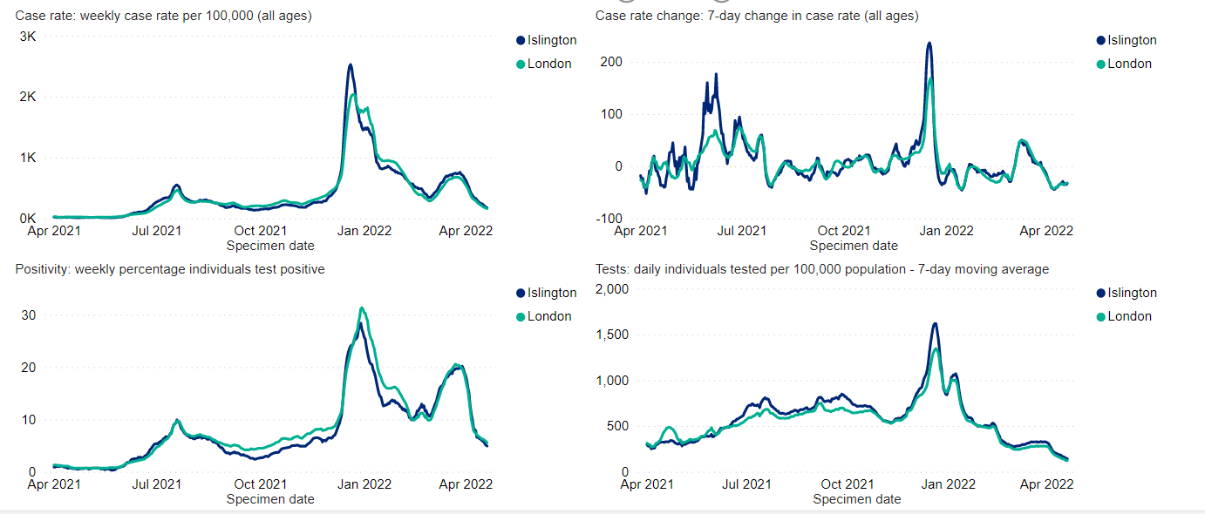
Summary of COVID impact to date – case rates and positivity
Week ending 20th April 437 new cases, giving a rate of 176 per 100,000 a 33% reduction from previous week. This rate is slightly higher than London, 162 per 100,000
Testing rates have decreased. Week ending 20th April, rate of testing is 141.3 per 100,000, 24% reduction from previous week. London’s testing rate is 121 per 100,000

Slide 4
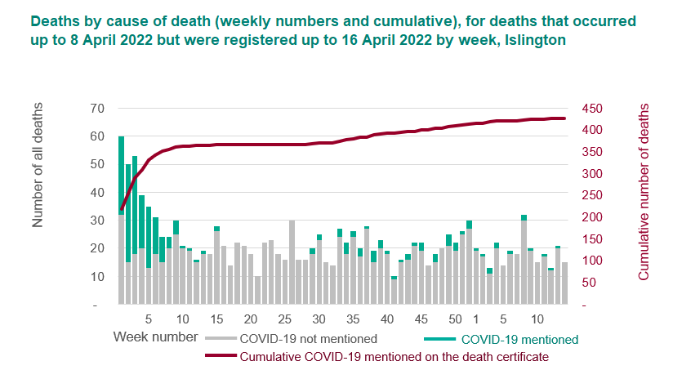
Summary of COVID impact to date – mortality
There have been a total of 427 deaths in Islington, with COVID19 mentioned on the death certificate.
This is a rate of 172 per 100,000 which is lower than the rate for London, 258 per 100,000, and England, 290 per 100,000.

Slide 5

Overview of Outbreak Control Measures – Vaccination
Among Islington residents age 18+…
67.56% have received a first dose.
62.67% have received two doses.
46.84% have received a third or booster dose.
These rates are comparable to vaccination rates in other inner London boroughs.
Within Islington, vaccination uptake is…
Higher amongst older residents, compared to younger residents.
Highest in White British and Irish residents, with lowest uptake in Black residents.
Comparable or higher amongst residents who are housebound, have learning disabilities, and severe mental illness in first and second doses compared to the overall Islington population.
In recent months, vaccination uptake has slowed down.

Slide 6
Overview of Outbreak Control Measures – Vaccination
Islington residents can access vaccination in a range of locations…
Provision | Details
General Practice | Mildmay Medical Practice – offering vaccination to residents registered with an Islington GP via their own booking system. Hornsey Rise Health Centre – offering vaccination to all via walk-in or via the National Booking System.
Community Pharmacy | Five community pharmacies are offering COVID vaccinations – Dermacia, Wellcare, Savemain, Well, and Leoprim – via the National Booking System.
Pop-up clinics | Resource for London will be offering vaccination to all via walk-in or via the National Booking System until the end of June 2022.
Vaccine outreach | Vaccination outreach is planned for a range of sites and events in the coming months, including Brickworks Community Centre, Finsbury Park Mosque, and a Learning Disability Partnership event.

Slide 7





Overview of Outbreak Control Measures – Vaccination
To promote vaccination and address inequalities in uptake, officers are working with partners on a range of actions, including…
Community engagement (funded via DLUHC Community Champions money)
Working with UCLH and VCSE partners to arrange vaccine outreach opportunities in trusted community locations, targeted to address inequalities
Sharing information, advice, and campaigns about vaccinations and access to vaccines with residents and staff, including targeted messaging on vaccinations and pregnancy
Delivering a small grants programme for targeted community engagement by VCSE organisations working with young people and inclusion health groups
Commissioning a youth-focused comms agency to develop engagement plans for young residents

Slide 8

Overview of Outbreak Control Measures – Testing
As part of the national Living with COVID Plan, universal access to symptomatic or asymptomatic COVID testing ended effective April 2022.
Now testing is available for…
People in hospital (including people being discharged from hospital into a care home.)
People who are eligible for community COVID drug treatments due to their higher risk of
becoming seriously ill if they become infected.
People asked to test by a GP or healthcare professional
Adult Social Care settings – via institutional arrangements.
NHS staff – via the national portal.
Some Adult Social Care staff – via the national portal.
In addition, the Council has made testing available for staff in key services for a time-limited period, and recently provided a limited number of tests to Special Schools and care homes.

Slide 9




Overview of Outbreak Control Measures – Wider Safety Measures
In addition to messages about vaccinations, the Council is also sharing wider keep safer messages to residents and staff, including promoting the importance of:
Indoor
ventilation
Outdoor
socialising
Hand
hygiene
Mask
wearing

