Slide 1
Arsenal in the community
Vision for a growing Health & Wellbeing offer

Slide 2
Local priorities
Islington, Camden & Hackney have a combined estimated population of over 800,000
Cancer, Cardiovascular disease & Respiratory diseases are leading causes of death across Islington & Haringey
Diabetes & High blood pressure also significantly contribute to early death and there is a growing black and Asian population in the area
Islington has the highest diagnosed rate of S.M.I in the whole of London
Ensuring good access to and uptake of preventative interventions is key to improving health and wellbeing outcomes for people, particularly with learning disabilities
Islington has the highest estimated dementia diagnosis rate in London, at 91%, significantly higher than London and England. Haringey is closer to the London average at 69%. This is an opportunity to link in with a high performing team.
* Source: Haringey & Islington JSNA 2017

Slide 3
Projects for PROBLEMs
Cancer → CanRehab
Obesity → Weight Management
Level 4 Cancer Rehab Qualified Staff
Group or 1 to 1 basis
Secondary Care Engagement
Key Charity Partners- CRUK, Macmillan, Prostate UK
Develop programme based on ‘Shape Up’ Model
Group based. Create sustainable elements.
Primary Care, CCG & Pub Health Engagement
Utilise fanbase & brand for initial launch
Inactivity → Get Active/S.P
Mental Health → Wellbeing
Exercise Referral Specialist lead
Links with community are vital for prescribing
Strong local knowledge for signposting
Possible links with commercial providers
Segment programme by age groups
School based & community-based delivery
Engagement with CAMHS, MIND & NHS Foundation
Programme to be developed with clinical help
Frailty → Older Adults Prog
Other
Exercise, Reminiscence, Football/General History
Ex Player visits/talks. Encourage family support
Age UK & Citizens advice key partners
Childrens weight management (competition)
Long Term Conditions Programme (Cardiac, Neuro)
Gambling/Alcohol addiction?

Slide 4



Health & Wellbeing Focus Areas
Focus 1
Enabling people to be more physically active & maintain a healthy weight
Focus 2
To increase awareness of MH challenges and provide effective interventions
Focus 3
To maintain and/or improve quality of life for the elderly or those with long term conditions

Slide 5
OUR COMPETITION/Potential Partners
H&W Project Competitors
Other Competitors
WW, Slimming World, Xyla
Exercise Referral Schemes
Local Leisure Operators- Better/GLL
Mental Health Service providers
NDPP
CCO’s- Geography & Politics
CCG/Public Health commissioned services
Commercial Gyms & Providers
Man vs Fat
Netflix
The Pub

Slide 6
TWO-YEAR ACTION PLAN
W.M P2 Plan & Network
Oct-Dec 22
Project 2 Plan & Network (M.H/O.P/LTC)
July-Dec 22
Induction, Plan & Network
Launch & Deliver W.M Offer P1
May-July 2022
July-Dec 22
2022
JAN
FEB
MAR
APR
MAY
JUN
JUL
AUG
SEP
OCT
NOV
DEC
2023
JAN
FEB
MAR
APR
MAY
JUN
JUL
AUG
SEP
OCT
NOV
DEC
Launch W.M P2 & ‘Hub’ 1
Launch W.M P3
Assess Funding & Hub Income
Launch W.M P4?
Jan- April 23
April-July 23
Sep-Dec 23
Launch Project 2
Monitor Project 2, Embed referral pathway
Launch Hub 2
Gather feedback & Evaluate 18 months & Begin Plan & Network for Project 3
Jan 2023
July 23

Slide 7
SUMMARY
With a relatively blank slate and by starting with a proven weight management model, there is an opportunity for Arsenal in the Community to build a more sustainable H&W department in comparison to other CCO’s, that still works for its community.
By learning from past mistakes that I have witnessed in the industry and capitalising on local and national priorities ahead of trends, I believe that within 5 years Arsenal could have one of the best CCO health and wellbeing offers in the premier league.
I also believe that elements of sustainability being built in from the very beginning will allow projects to scale more quickly and will make them more attractive to funders.

Slide 8
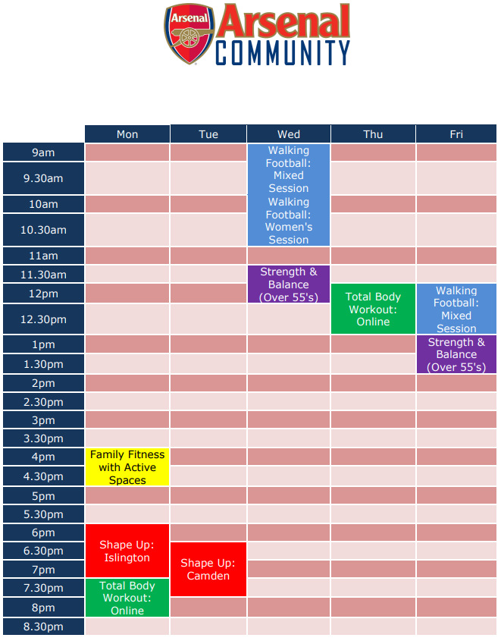

Slide 9
THANK YOU
Rhys Ratcliffe
07548 107576
rratcliffe@arsenal.co.uk

