Slide 1

Cost of Living campaign
Launched: 6 September 2022
Purpose: support residents and businesses and promote the help and advice available to them.
Objectives:
Signpost and demystify the financial support
Help residents claim benefits they are entitled to
Increase awareness of other related support
Promote the importance of seeking help early
Influence national policy change
Target audiences:
Existing benefits claimants
Barely coping residents/staff
Businesses
Stakeholders and partners

Slide 2


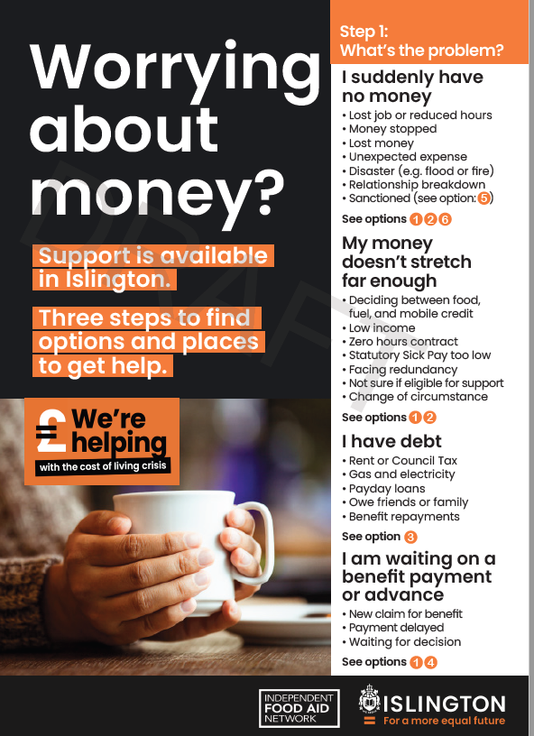

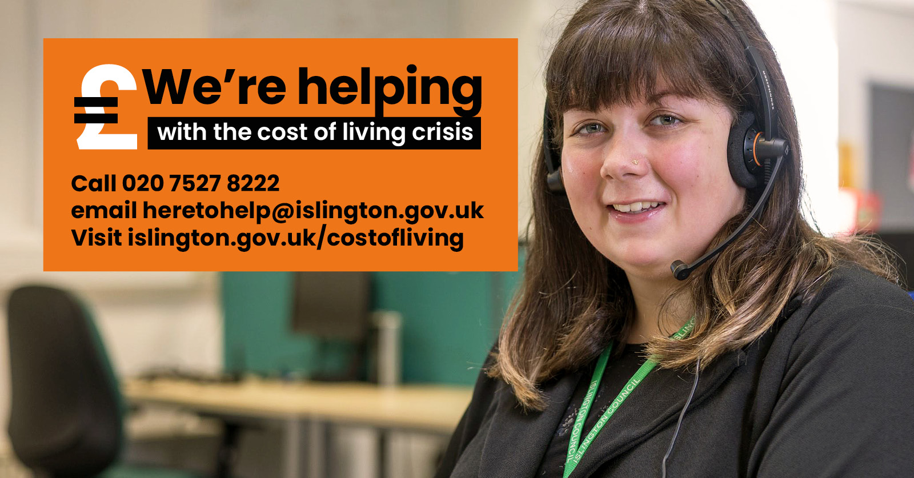
Approach
Clear and simple signposting
Staff provide the human face of the council
Dedicated phone number, email and web page
Leaflet, posters, social and digital assets, backs of letters
Co-designed a campaign toolkit with VCS partners
Piggybacking onto other activity

Slide 3
Highlights so far
When | What
6 Sept | Leader letter calling for support; Social media live; posters and leaflets in council and community outlets; cost of living pages updated, Estate Notice Boards. Staff campaign launched.
9 – 10 Sept | Back to school mailing + programmatic advertising to parents Leaseholder mailing
15 Sept | Double page spread in Islingtonlife
22 Sept | Emergency declaration
26 Sept | VCS and member toolkit distribution
30 Sept | Tribune cost of living special
Outcomes: 800+ signed up to bulletin, thousands of visits to the web page, hundreds of calls to 8222,
over 30k leaflets being distributed from next week.

Slide 4
What’s coming up
Cost of living summit – 3 October
20k leaflets distributed to VCS – w/c 3 October
15k leaflets distributed in the rent statement – mid October
Cost of living support listed in SHINE mailing – from 3 October
First cost of living e-bulletin (focus on energy savings and support) – w/c 10 October
Expand campaign to cover other areas of support (e.g. housing and energy)
Develop an approach for the cost of doing business

